Slide 1
Following Integer
Kaneez Fathima

Slide 2
Challenge Description
Challenge appeared in previous google competition
Suppose you have a fixed list of digits chosen from the range 1..9. What numbers can you make with them? You’re allowed as many zeros as you want.
Write the numbers in increasing order.
Example : if you are writing your number with two 1’s and one 5
1,1,5
Possible list in ascending order :
115,151,511,1015,1051
Constraint : The number of 1s,2s,…9s is fixed but number of 0s is arbitrary.

Slide 3
Input : Each test case will contain an integer n < 10^6.
Output: For each test case output which is the next integer in the list.
115 -> 151
842 -> 2048
8000 -> 80000
50110812884911623516 → 50110812884911623561
82454322474161687049 → 82454322474161687094
82040229261723155710 → 82040229261723157015
43888989554234187388 → 43888989554234187838
76080994872481480636 → 76080994872481480663
31000989133449480678 → 31000989133449480687
20347716554681051891 → 20347716554681051918

Slide 4
Approaches
Approach 1
Lexicographical ordering
As in dictionary which provide lexicographical ordering where all words which begin with A appear before words that begin with B
Example
Input :123
Output :
123
132
213
231
312
321

Slide 5
If two words start with the same letter, pop that letter from the head of the word and compare their tails, and apply this rule recursively
AAADKRRV
AAADKRVR
AAADKVRR
...
AARDVARK
...
VRRKAADA
VRRKADAA
VRRKDAAA

Slide 6
C++ has a built in function std::next_permutation as part of algorithms library
Next_permutation ouputs lexicographically ordered permutations for the input range
sorts an input range, one step at a time. When next_permutation eventually returns false, the range will be perfectly ordered.
Issue: Complexity : O(N!)
When compared to most sorting algorithms that are O(N log N)
Even Bubble sort has takes O(N ^ 2) .
Elegant but inefficient

Slide 7
Approach-2
Divide the number into prefix and suffix where suffix is longest possible decreasing tail of the given Number
We start with a range delimited by a pair of bi-directional iterators first and last
Case 1: If the suffix is whole range with no prefix(insert 0)
Then the given range is at its lexicographical maximum cannot be increased by permuting its digits
So reversing the range and then inserting 0 between 1st and 2nd digit will returns its lexicographical minimum
Read the Given input Number in reverse order (iterator last) and check if all the digits are in ascending order
If yes then reverse the digits to get 248 and insert 0
842 between 1st 2nd digit ----→ 2048 (as this is next largest number that can be formed with digits 2,4 and 8 and using arbitrary number of 0s

Slide 8
Case 2: If the suffix is not whole range and has a prefix
8342666411 -> 8342 666411
The longest decreasing suffix is 666411, and the corresponding prefix is 8342.
666411 lexicographical maximum cannot be increased by permuting its digits
To find the next permutation, we must increase the Prefix
Find the smallest Suffix element larger than the Prefix's (8342)final digit 2.
Walking back from the end of Suffix, the first element greater than 2 is 4.
8342 666411
Swap the 2 and the 4
8344 666211
Since head has increased to reduce to the next permutation, we reverse Suffix, putting it into increasing order.
8344 112666
This approach can be solved in linear time

Slide 9
Number
Digit Index
Traverse the digits from Right to left and check if digits in ascending order. Get the index where the order breaks
At index 1 the order breaks as 4 < 8
As digits from index 2 to 5 are in descending order so find the next largest number or digit to 4
So 5 is next largest number to 4.Swap 4 and 5’s
Since digits in index 2 – 5 are in descending order so in order to obtain the next largest number digits from index 2-5 need to be reversed
7 | 4 | 8 | 6 | 5 | 1
0 | 1 | 2 | 3 | 4 | 5
7 | 4 | 8 | 6 | 5 | 1
0 | 1 | 2 | 3 | 4 | 5
7 | 5 | 8 | 6 | 4 | 1
0 | 1 | 2 | 3 | 4 | 5
7 | 5 | 1 | 4 | 6 | 8
0 | 1 | 2 | 3 | 4 | 5

Slide 10
Code
include <stdio.h>
#include <string.h>
#define INVALID_INDEX (-1)
#define BUFF_SIZE (1024)
int main(int argc, char *argv[]) {
char buff[BUFF_SIZE];
FILE *fp = NULL;
if ((fp = fopen(argv[1], "r")) == NULL) {
printf("Input file not found...\n");
return -1;
}
while (fgets(buff, sizeof(buff), fp) != NULL) {
int i = 0, cur = 0, len = 0;
if (buff[strlen(buff) - 1] == '\n') {
buff[strlen(buff) - 1] = '\0';
}

Slide 11
len = strlen(buff);
cur = len - 2;
/* Traverse the number Right to left to check if the digits are in ascending order if not break from the loop to get the index where the order is broken */
while ((cur >= 0) && (buff[cur] >= buff[cur + 1])) {
cur -= 1;
}

Slide 12
/* Case 1: If the suffix is whole range with no prefix */
if (cur == INVALID_INDEX) {
/* Reverse the Number to get 248 */
string_reversal(buff, 0, len - 1);
if (buff[0] == '0') {
int indx = 1;
while (buff[indx] == '0') indx++;
byte_swap(&buff[0], &buff[indx]);
}

Slide 13
/* After reversing the number add 0 after 1st digit to get 2048 */
for (i = 0; i < len; i += 1) {
putchar(buff[i]);
if (i == 0) putchar('0');
}
putchar(“\n”);

Slide 14
else { /* Case 2: If the suffix is not whole range and has a prefix */
int end = len - 1;
while ((end > cur) && (buff[end] <= buff[cur]))
end -= 1;
byte_swap(&buff[cur], &buff[end]);
string_reversal(buff, cur+ 1, len -1);/* Reverse the Suffix */
for (i = 0; i < len; i += 1) {
putchar(buff[i]); /*Display the Result */
}
putchar('\n');
}
}
fclose(fp);
return 0;
}

Slide 15
void byte_swap (char *p1, char *p2)
{
char temp = 0;
if (!p1 || !p2) return;
temp = *p1;
*p1 = *p2;
*p2 = temp;
}

Slide 16
void string_reversal (char *str, unsigned int start, unsigned int end)
{
char temp = 0;
if (!str || (start == end)) return;
while (start < end) {
temp = str[start];
str[start] = str[end];
str[end] = temp;
start++;
end--;
}
}

Slide 17
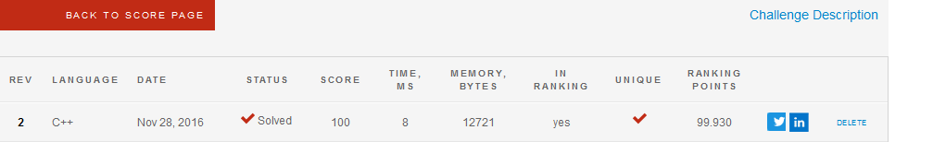
Approach -1

Slide 18
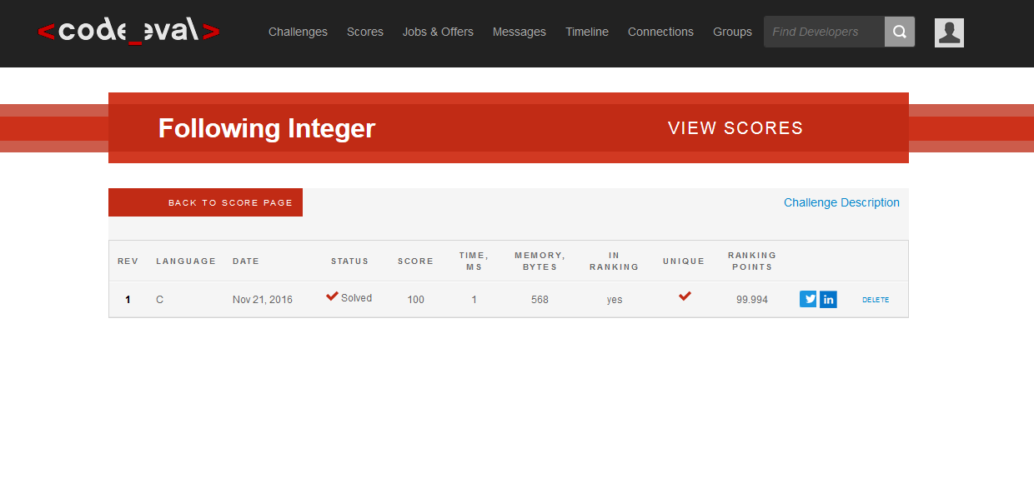
Approach 2

Slide 19
Thank You

